Slide 1

Note: The data and information in this document is reflective of a hypothetical situation and client. This document is to be used for KPMG Virtual Internship purposes only.
Sprocket Central Pty Ltd
Data analytics approach
[Division Name] - [Engagement Manager], [Senior Consultant], [Junior Consultant]

Slide 2
Note: The data and information in this document is reflective of a hypothetical situation and client. This document is to be used for KPMG Virtual Internship purposes only.
Agenda
Introduction
Data Exploration
Model Development
Interpretation

Slide 3
Note: The data and information in this document is reflective of a hypothetical situation and client. This document is to be used for KPMG Virtual Internship purposes only.
Introduction
How to define customer value
Recency, Frequency, Monetary Value (RFM) Model
Recency shows you how recently a customer bought from your store.
Frequency reflects how often a customer purchases from your store.
The monetary value represents how much a customer usually spends with your store.
High score can be defined as high value customer.
Low score can be defined as low value customer.

Slide 4
Note: The data and information in this document is reflective of a hypothetical situation and client. This document is to be used for KPMG Virtual Internship purposes only.
Introduction
Pros and cons of customer value
Pros:
easy to quantify customer value
purchase behavior can be summarized by using a very small number of variables
popular in direct marketing segmentation for decades
Cons:
The threshold of the customer value could be tricky
Post-analysis customer behavior, not perform well in prediction new customer

Slide 5
Note: The data and information in this document is reflective of a hypothetical situation and client. This document is to be used for KPMG Virtual Internship purposes only.
Introduction
There is no relationship between customer value and the given data.
Because there is no relationship between the data, the prediction of every customer value prediction is just better than random guess.

Slide 6
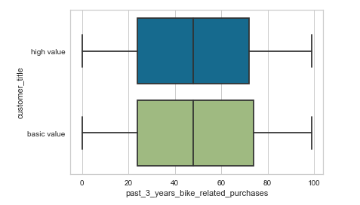
Note: The data and information in this document is reflective of a hypothetical situation and client. This document is to be used for KPMG Virtual Internship purposes only.
Data Exploration
The relationship between customer value and past 3 years bike related purchases.
T-test:
H0: there is no difference between differet customer value in bike purchases.
H1: there is a difference between differet customer value in bike purchases.
T-statistic = -0.035, p-value = 0.97.
Conclusion: because p-value > a (0.05), we can conclude that there is no difference between differet customer value in bike purchases in 95% confidence interval.
Place any supporting images, graphs, data or extra text here.

Slide 7
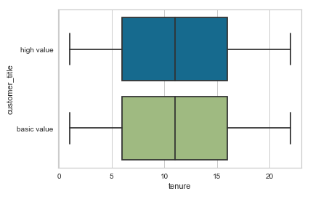
Note: The data and information in this document is reflective of a hypothetical situation and client. This document is to be used for KPMG Virtual Internship purposes only.
Data Exploration
The relationship between customer value and tenure.
T-test:
H0: there is no difference between customer value in tenure.
H1: there is a difference between customer value in tenure.
T-statistic = 0.09, p-value = 0.93.
Conclusion: because p-value > a (0.05), we can conclude that there is no difference between different customer value in tenure in 95% confidence interval.
Place any supporting images, graphs, data or extra text here.

Slide 8
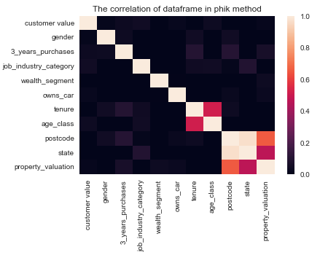
Note: The data and information in this document is reflective of a hypothetical situation and client. This document is to be used for KPMG Virtual Internship purposes only.
Data Exploration
The correlation between customer value and all features.
The row of customer value is all dark, which means there is no correlation or very weak correlation between customer value and all features.
Place any supporting images, graphs, data or extra text here.

Slide 9
Note: The data and information in this document is reflective of a hypothetical situation and client. This document is to be used for KPMG Virtual Internship purposes only.
Model Development
If there has to be a model to predict the customer value, even it is just better than random guess.

Slide 10
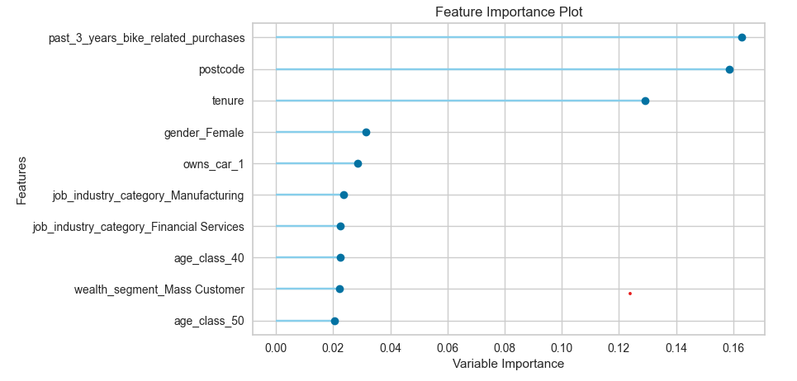
Note: The data and information in this document is reflective of a hypothetical situation and client. This document is to be used for KPMG Virtual Internship purposes only.
Model Development
Feature importance from random forest

Slide 11
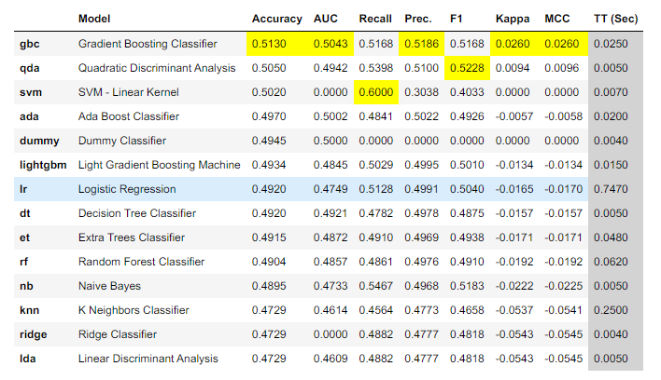
Note: The data and information in this document is reflective of a hypothetical situation and client. This document is to be used for KPMG Virtual Internship purposes only.
Model Interpretation
Test over 20 models, we choose Gradient Boosting Classifier

